Slide 1
Barangay system
KAmila lagman daren mar cabral david Warren Arcellana Jhonel Deluna

Slide 2
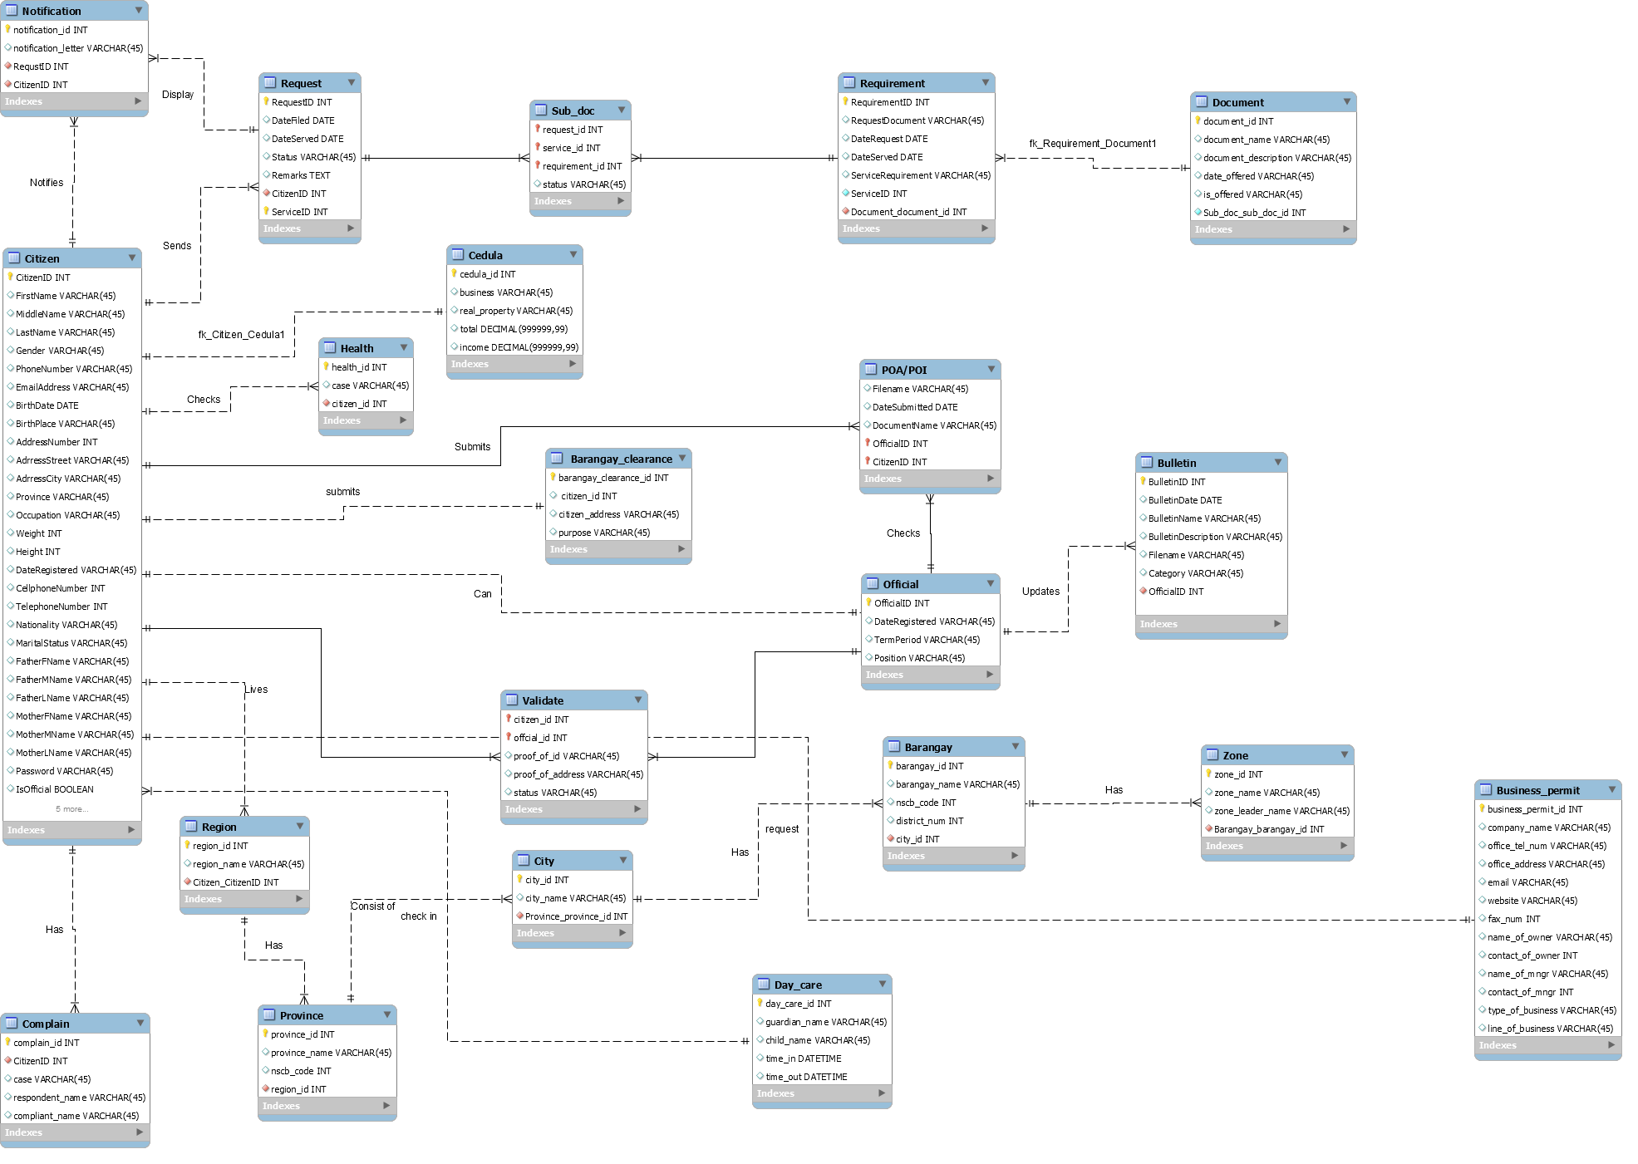

Slide 3
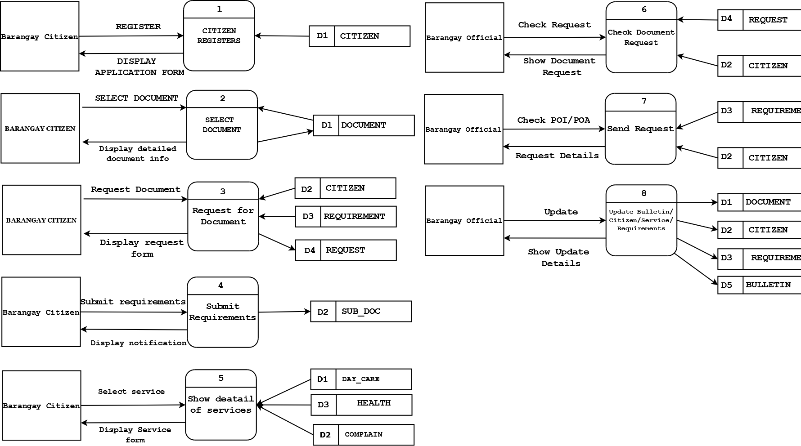
Dfd FRAGMENTS

Slide 4
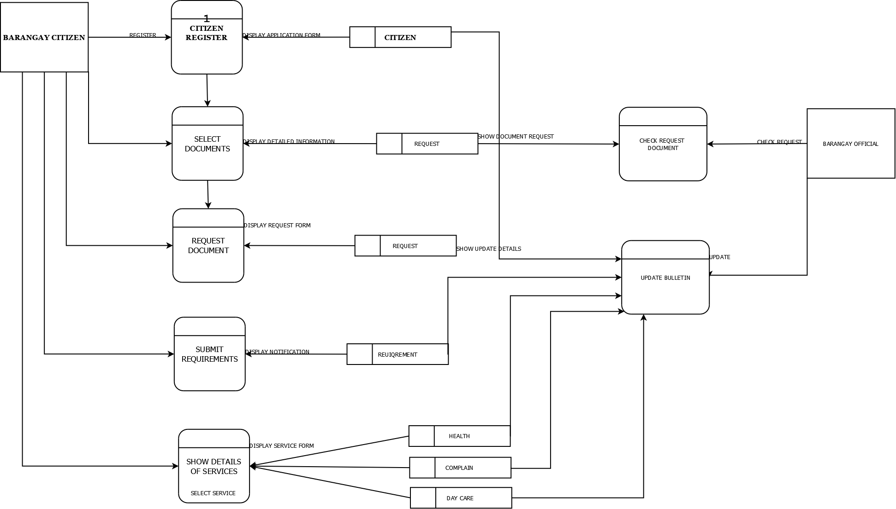
Dfd level 0

Slide 5
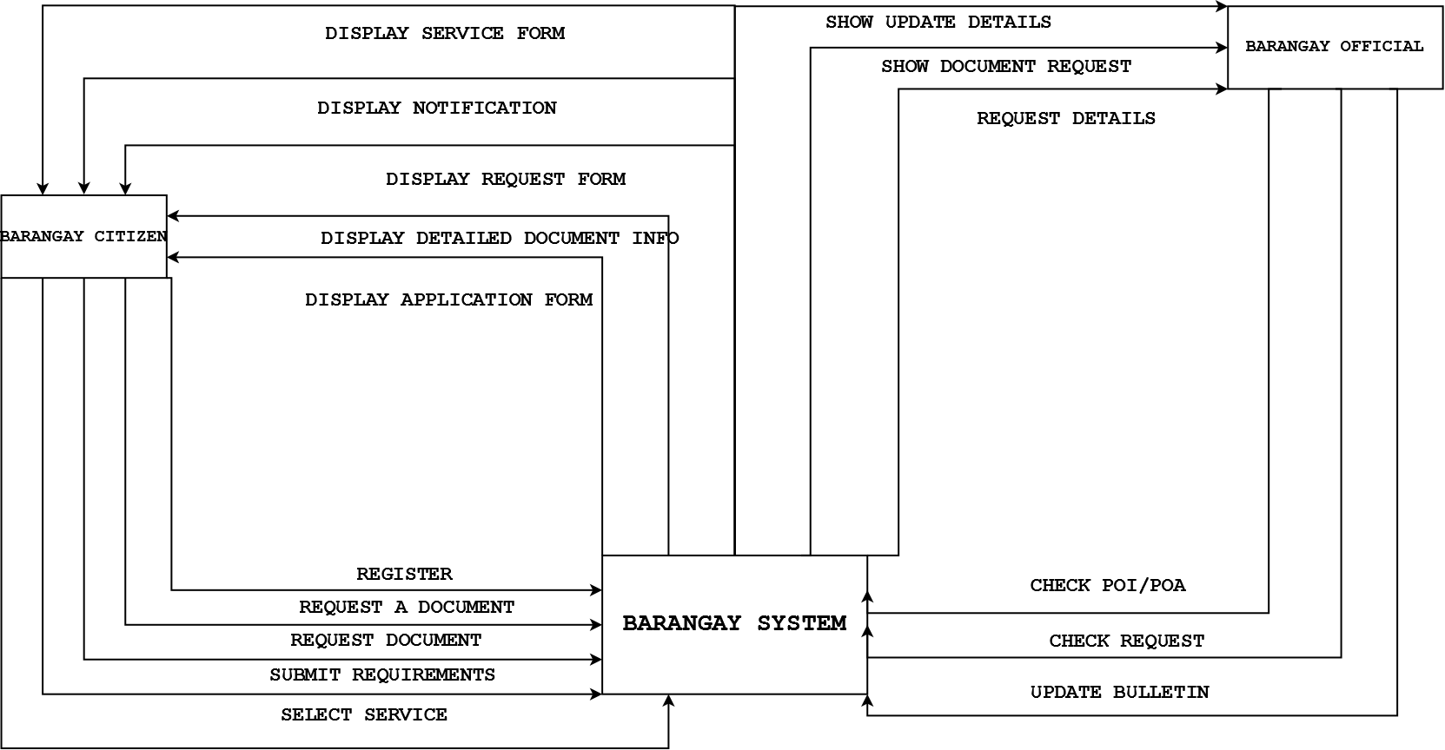
CONTEXT DIAGRAM

